Slide 1
Summary of What I Know So Far
Meagan Konst

Slide 2
Purpose
The purpose of these slides is to summarize what I know so far about my responsibilities as a member of the SBS Research Group.
Here I will document what has been done (admittedly little) as well as what needs to be done.

Slide 3
Goal
The goal of my contribution is to implement the pre-processing of data packets from the ASICs that are stored in memory that is accessible by the FPGA. First, this will be done in software; then, it will be done in hardware using optimized HLS.
The Big Questions: How well can HLS implement our design? How many ASICs can we process on one FPGA?
This pre-processing includes:
Pedestal Subtraction (for noise cancellation)
Time Integrals (over variable intervals)
Additional Algorithms (Centroiding, Zero Suppression, Multi-event detection, Data Compression)

Slide 4
Data Translation
One major component of this work is translating between various data types / configurations used by different parties.
The data packets are currently encoded as .dat files (from Gary) when they enter the system. When the data exits the system, it is as a space-delineated .txt file (to Marion).
More detailed descriptions of these data configurations are in the following slides.

Slide 5
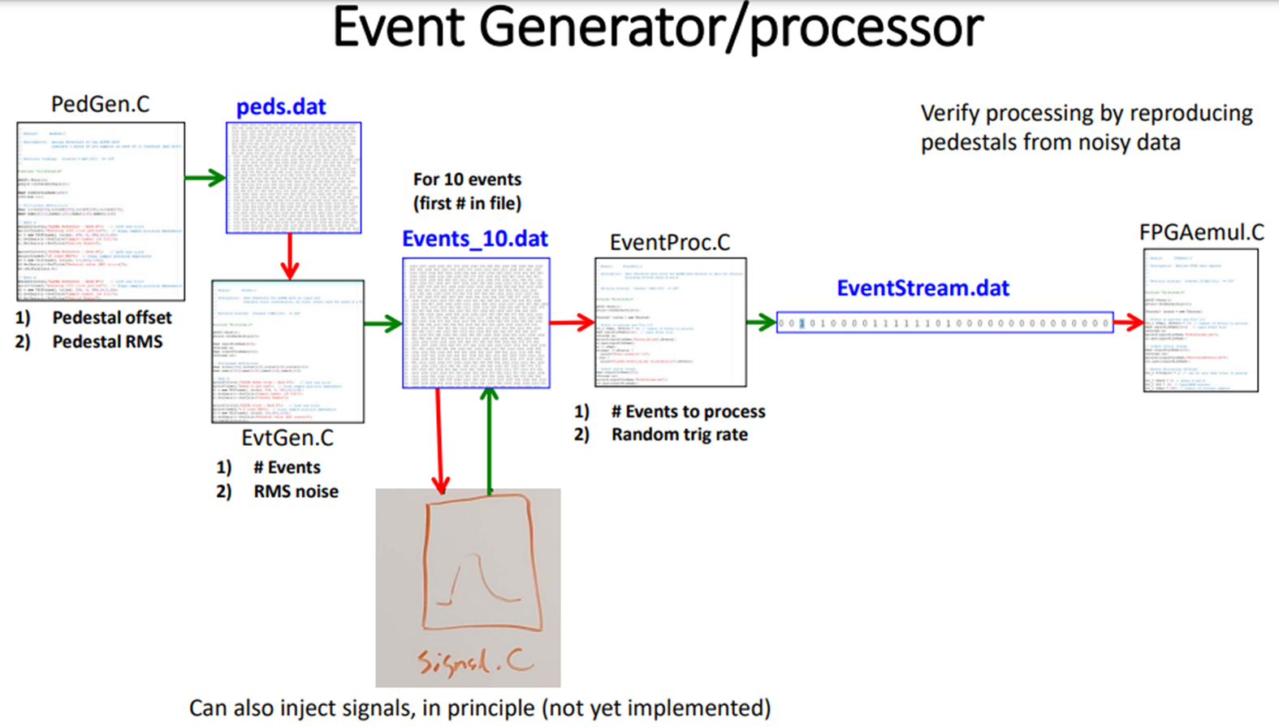
Input Data
Go to the GitHub link below for more information and the .c files listed below.
https://github.com/gsvarner/ALPHA-dataGen
This is our input data

Slide 6
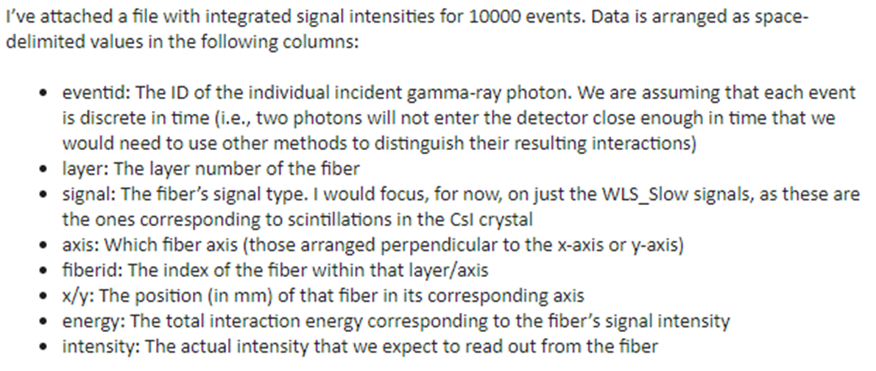
Output Data
See the digi_lite_apt_test.txt for an example file.

Slide 7
System Design
Here is a high-level overview of the system, with its necessary inputs and outputs
EventStream.dat
peds.dat
System Logic
sim_data.txt
Trigger Position
packet.json
(used for human-readable debugging)
Integral Intervals

Slide 8
Internal Data Structures
Inside of the System, there are two main data structures: Data_Packet and pedestals. These are meant to mimic the eventual representation of these data collections in memory. The format for a data packet is shown on the following slide.

Slide 9
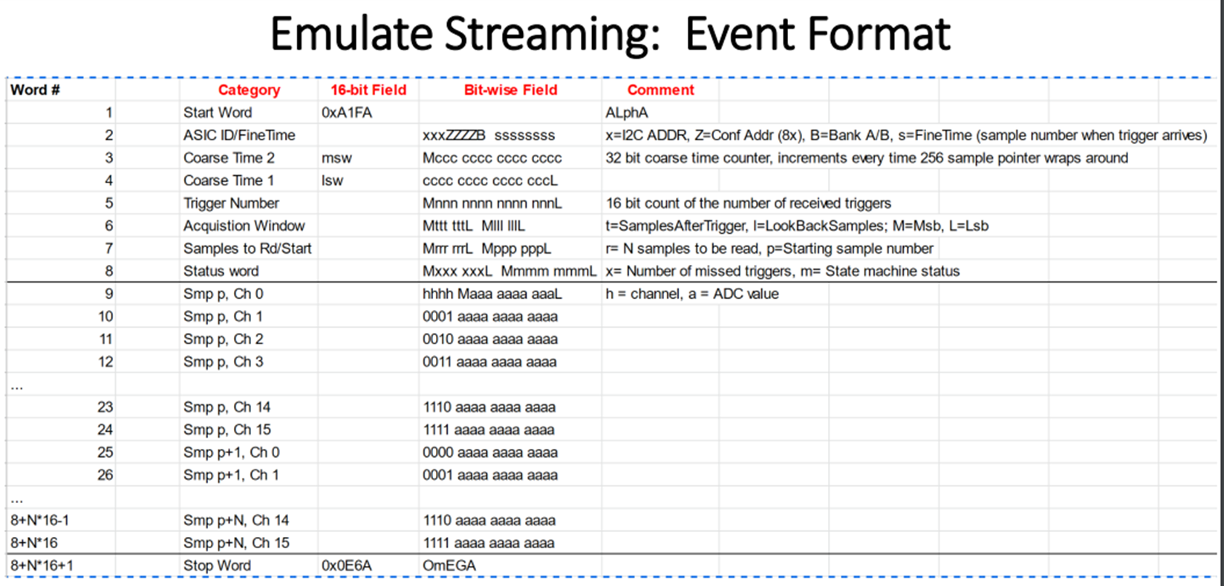
Data_Packet

Slide 10
System Logic
Inside the system, the following needs to be implemented:
Functions for data type translations
Pedestal Subtraction (signed result!! -> need an extra bit OR an offset)
A data dump for diagnostics
Time Integrals (really sums)
Centroiding
Zero Supression
Multi-event detection
Data Compression
Formatting Data Output (including information mapping)
The current implementation is rather lacking, but exists in the pre-proc-model.c file.

Slide 11
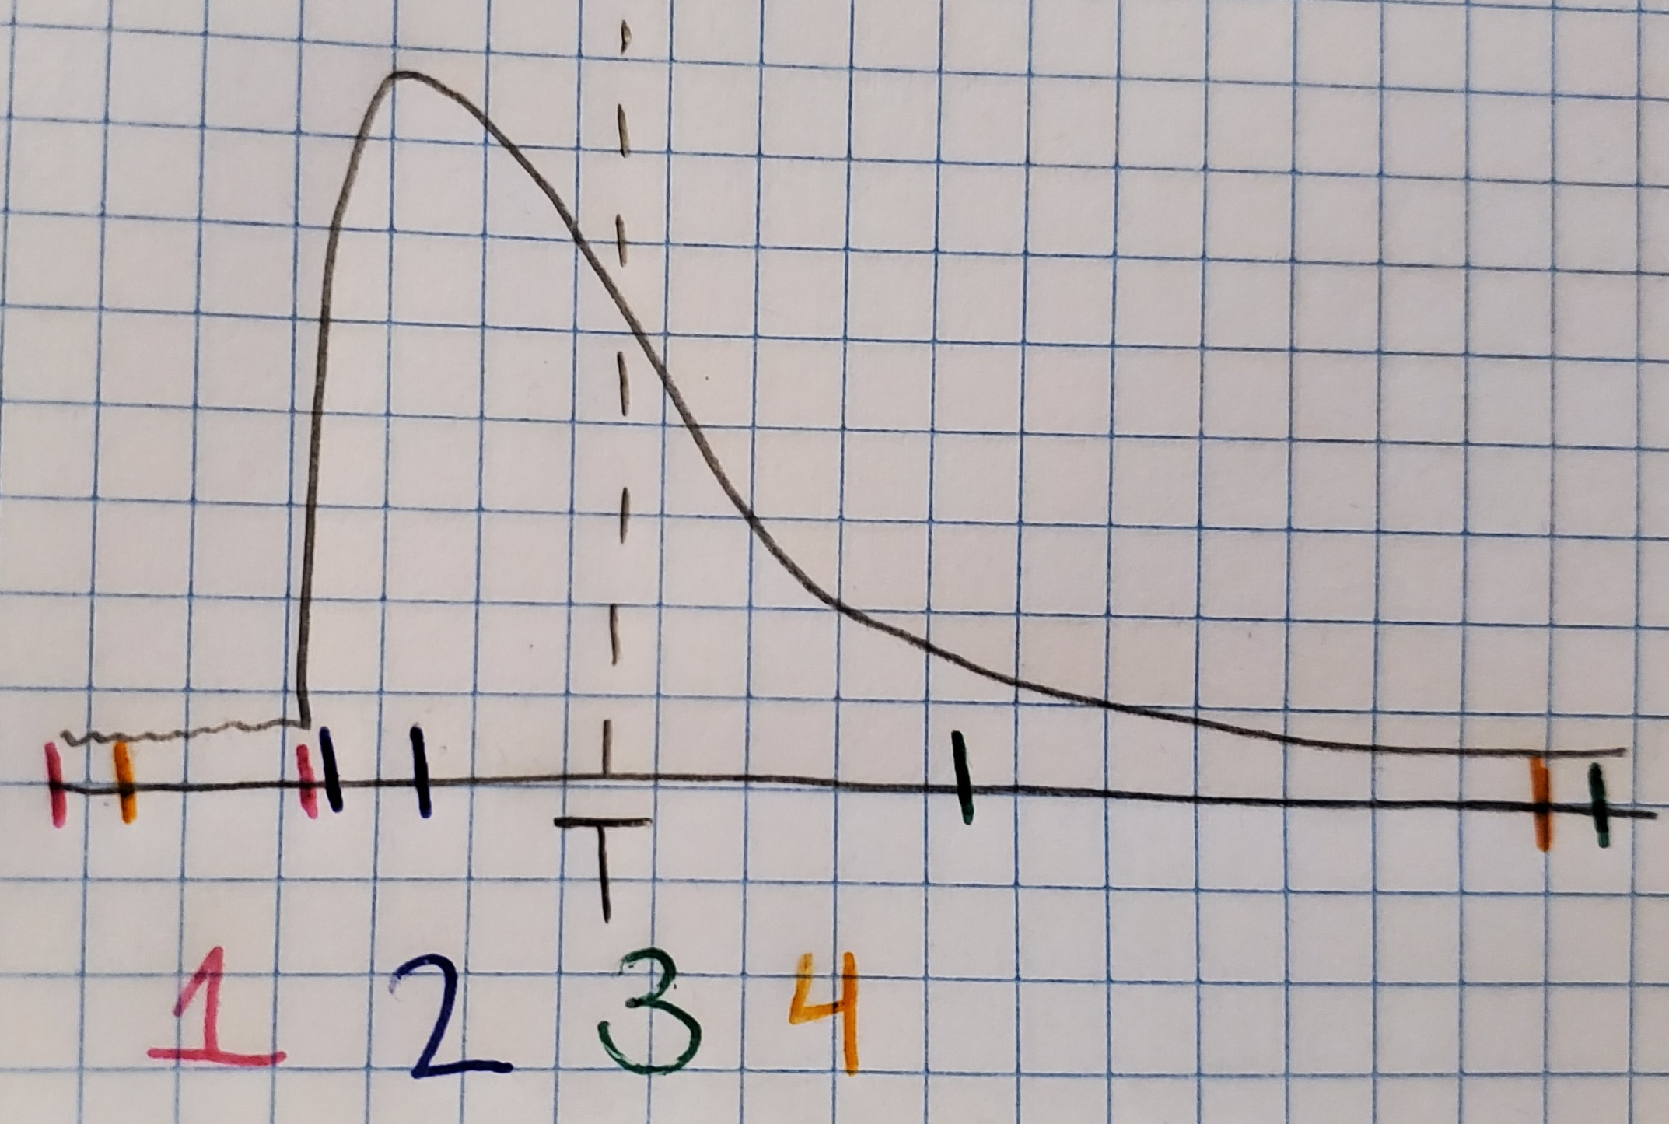
System Logic Blocks
Samples
(+ Offset)
Pedestal Subtraction (Samples – Pedestals)
4 Integrals
Pedestal in front of pulse
Short integral of front end
Long integral of tail end
Full (or almost full) buffer
Results
Pedestals
16x250x16
16x250x16
16x4x20*
16x250x16
Channels x Samples x Bits
*Could be 16x4x16 with FP Data Compression

